Slide 1
Anaerobic processes

Slide 2
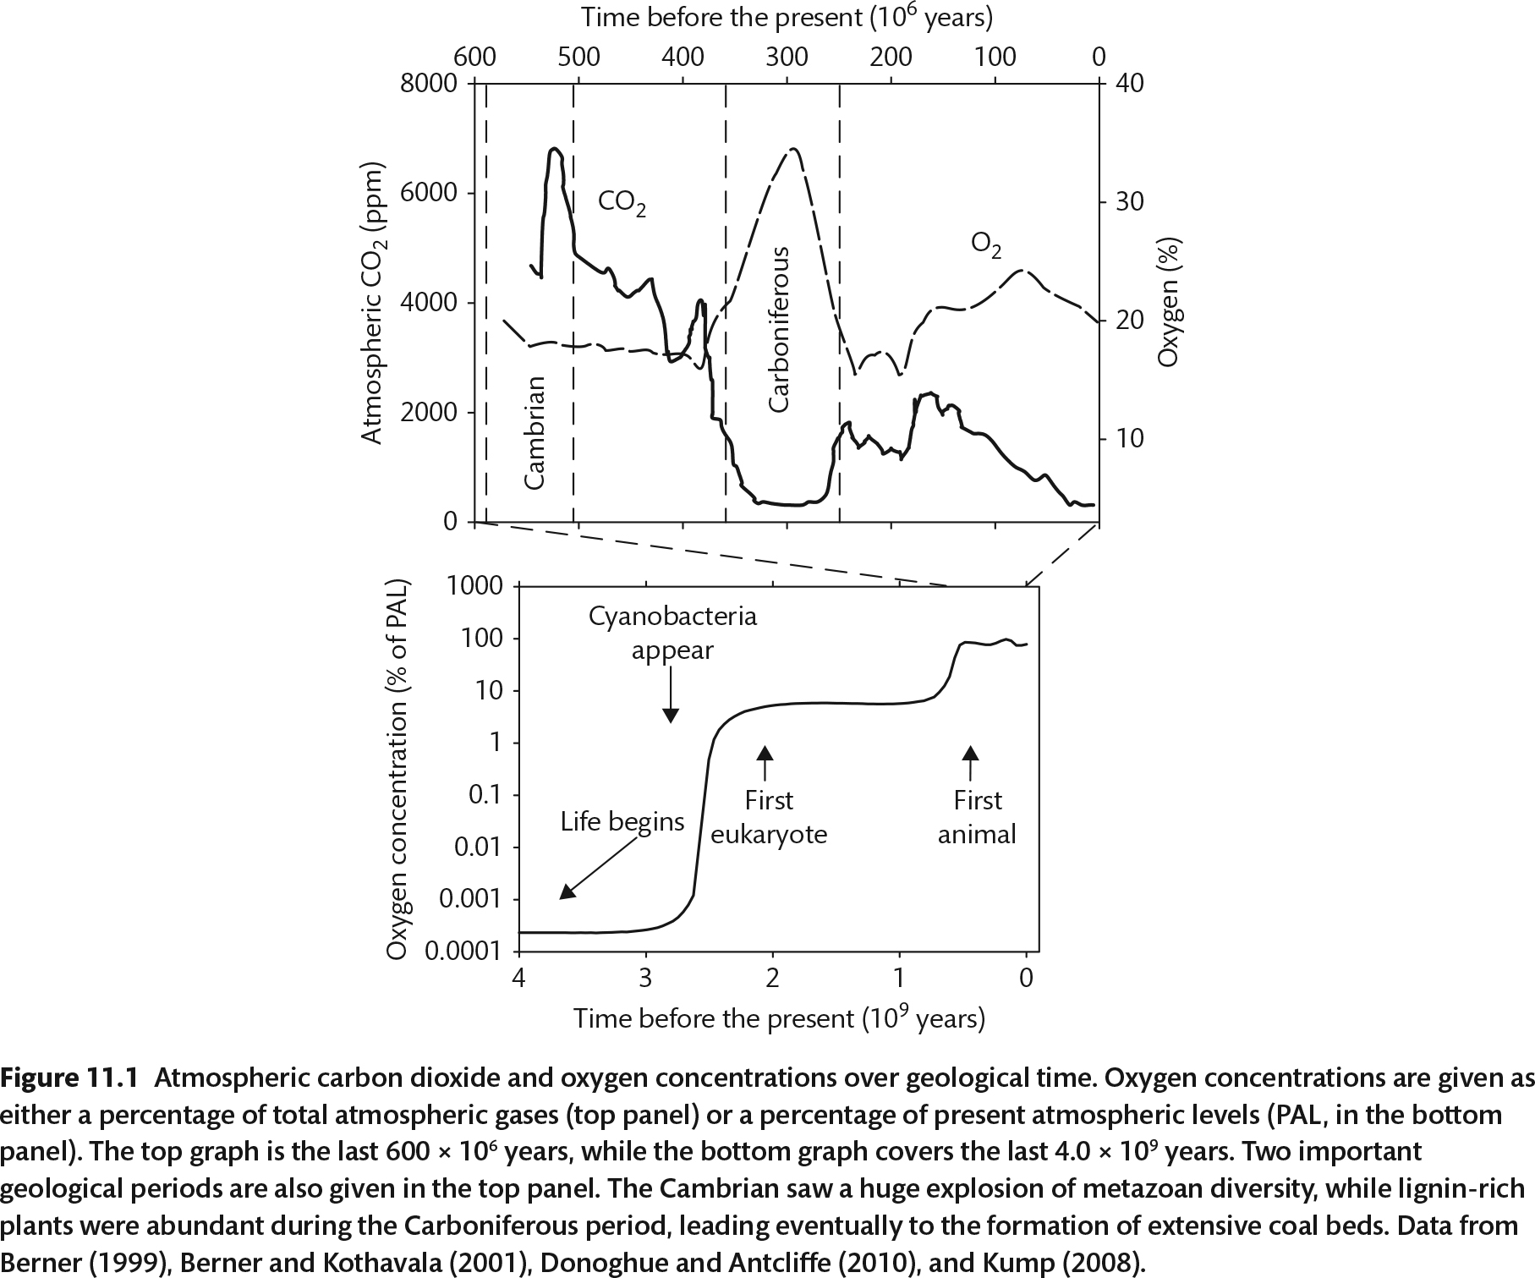

Slide 3
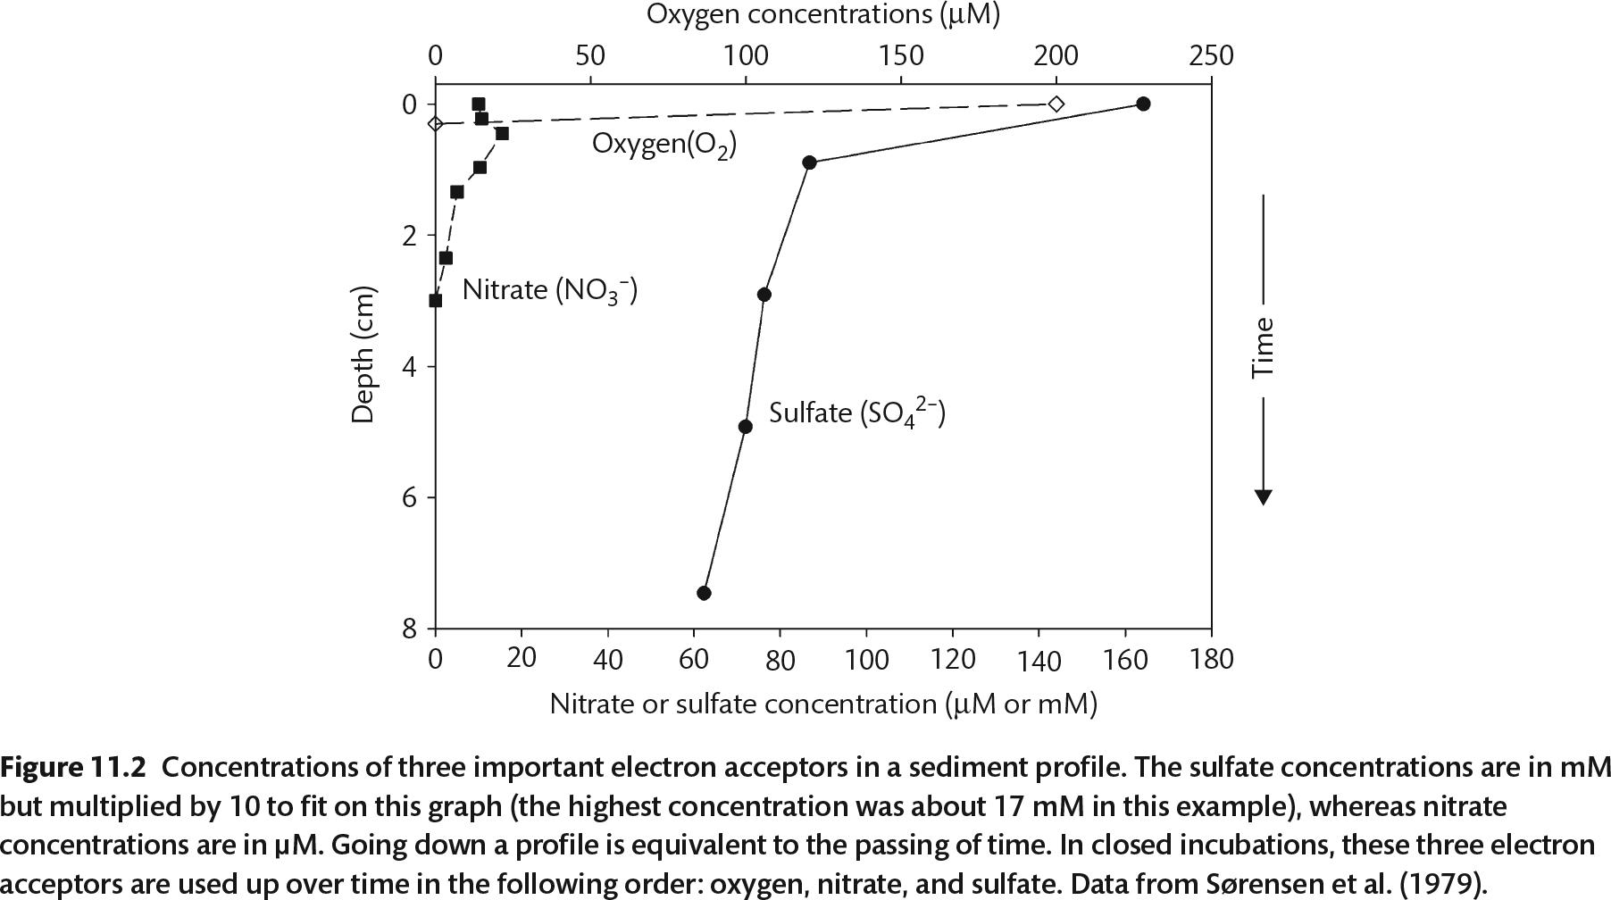
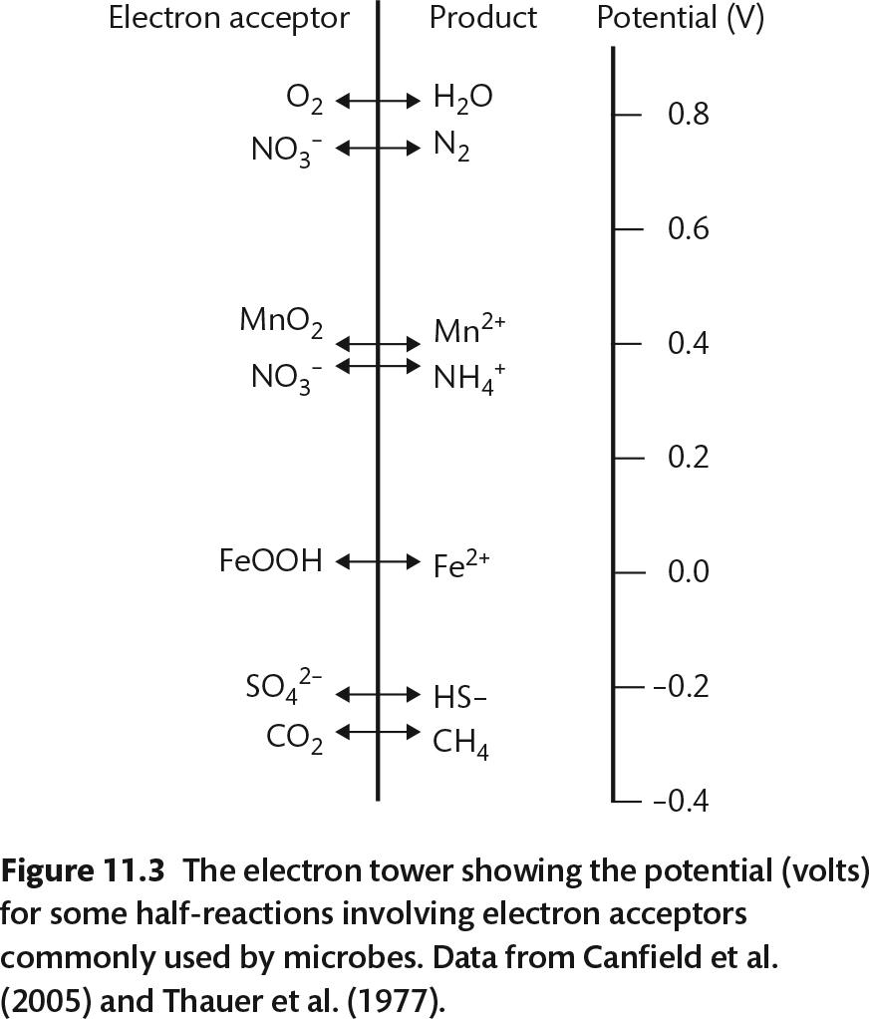

Slide 4
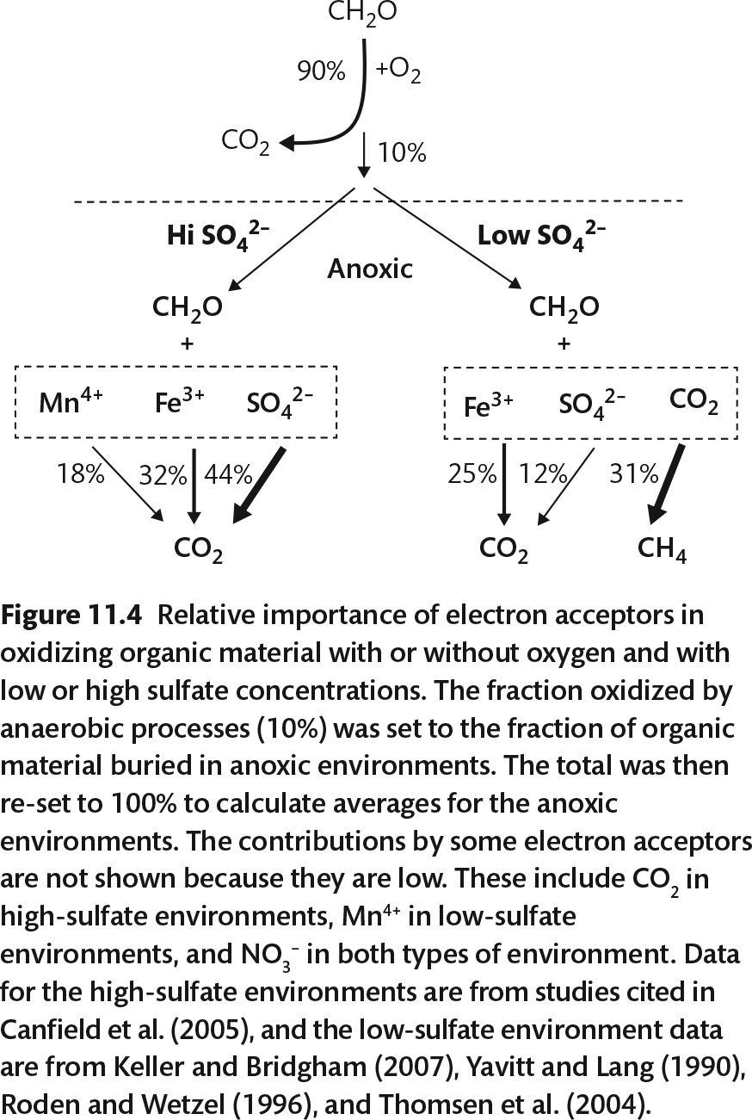

Slide 5
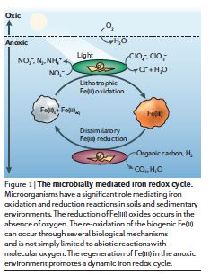
Oxidation/Reduction of metals
Challenge: beat abiotic
Soluble/insoluble
Impacted heavily by pH

Slide 6
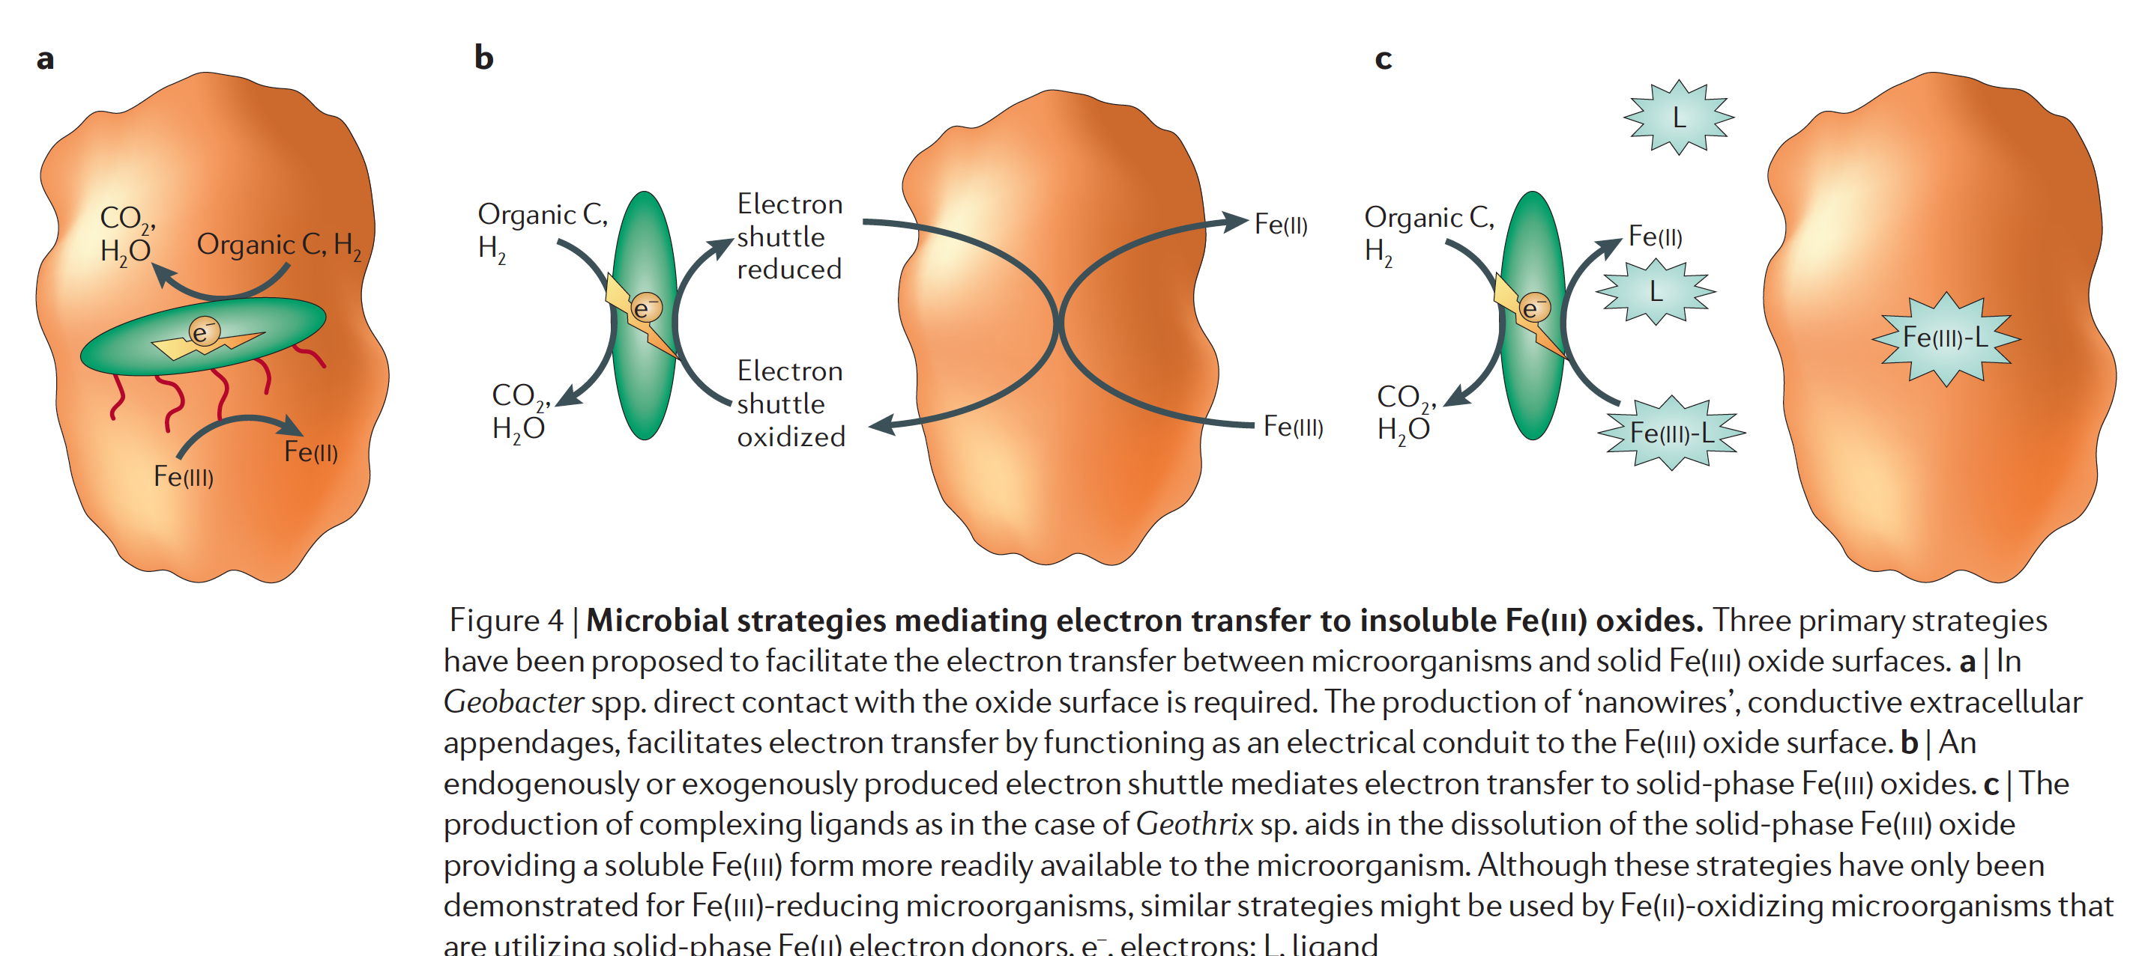
Weber et al. 2006

Slide 7
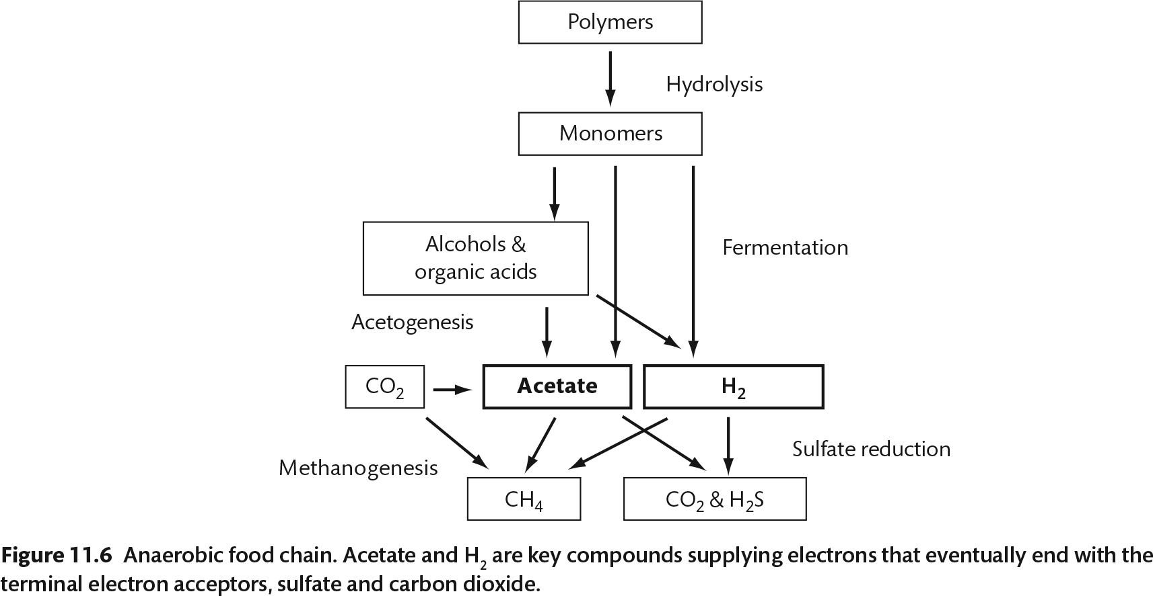

Slide 8
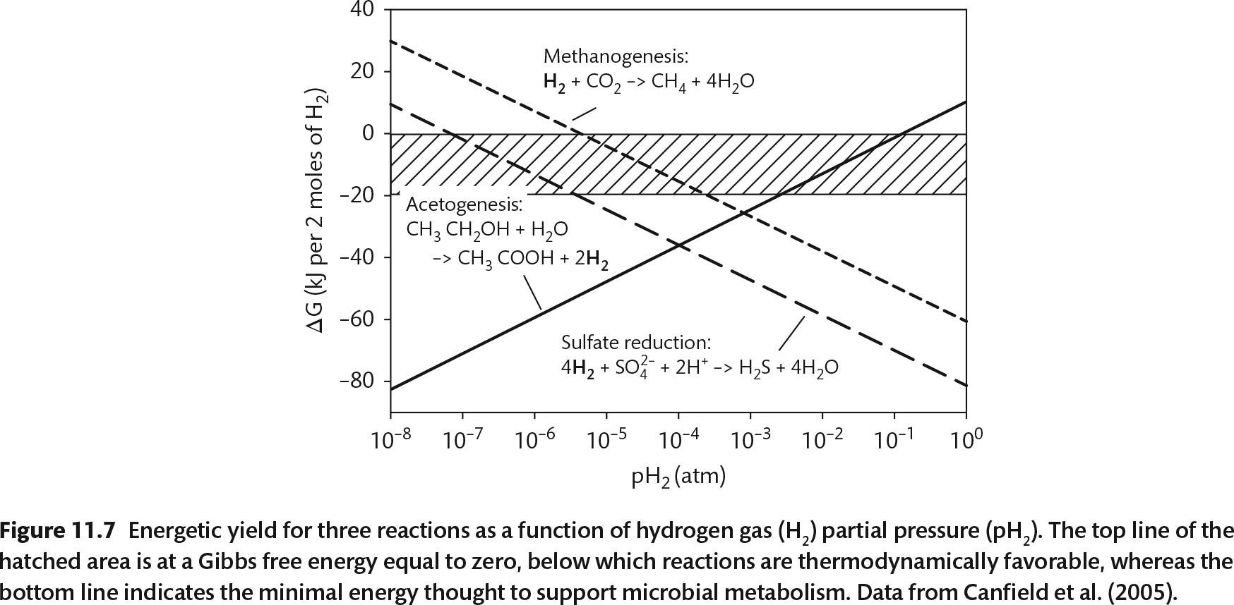

Slide 9
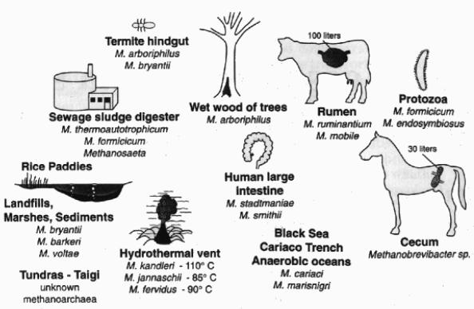
Methanogenesis
Production of methane
From carbon dioxide, acetate or methylamines
Only performed by archaea
Methanogens

Slide 10
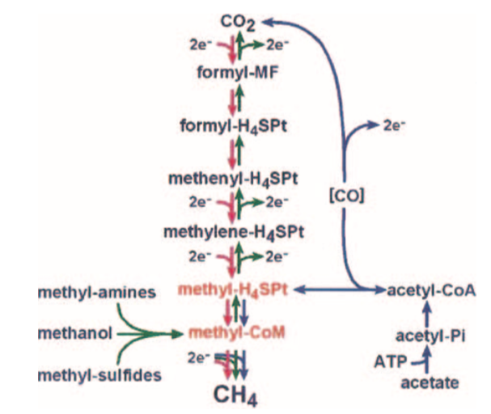
Methane pathways

Slide 14
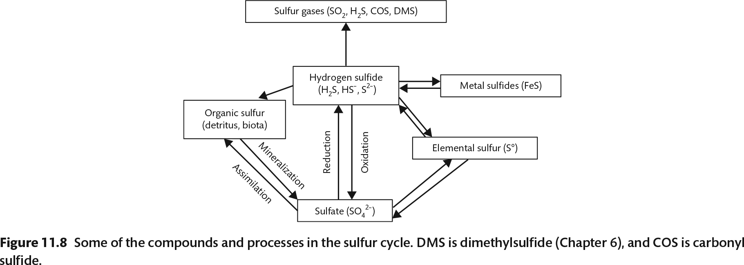
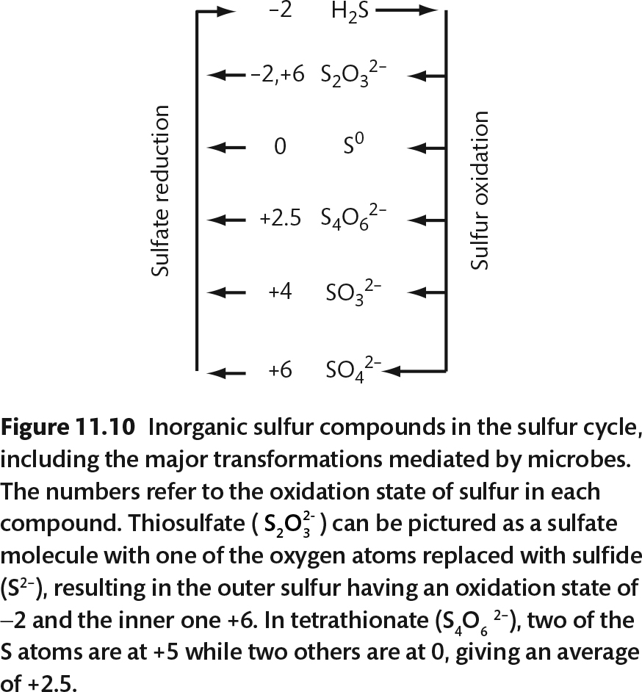

Slide 15
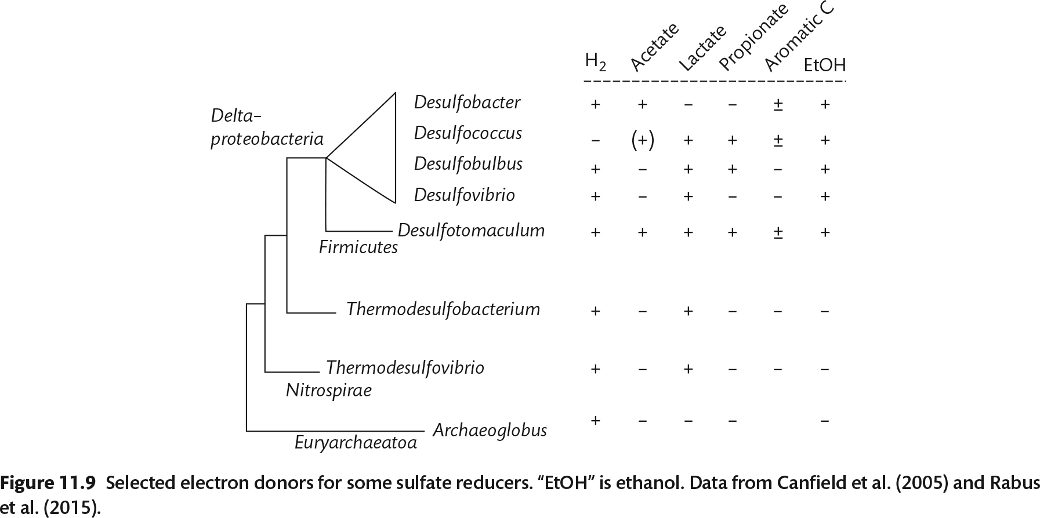

Slide 16
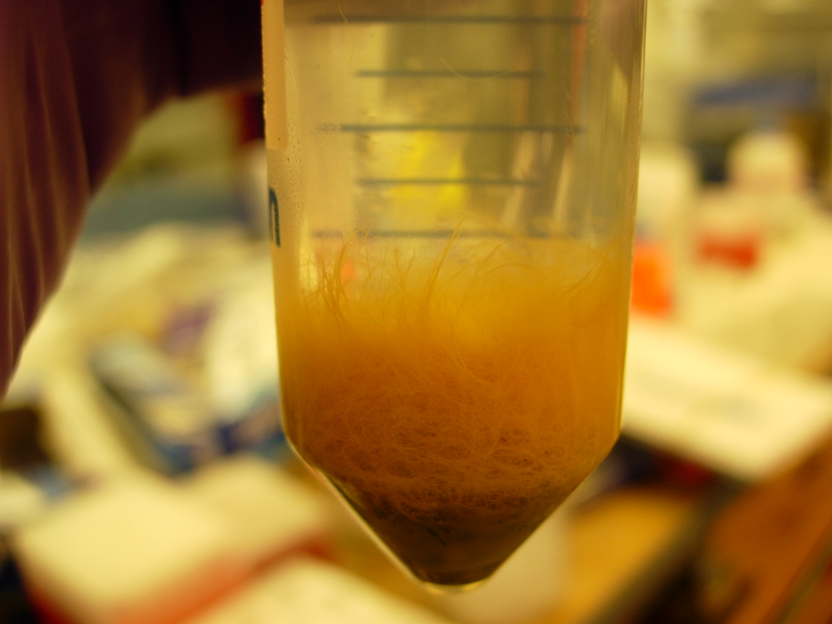
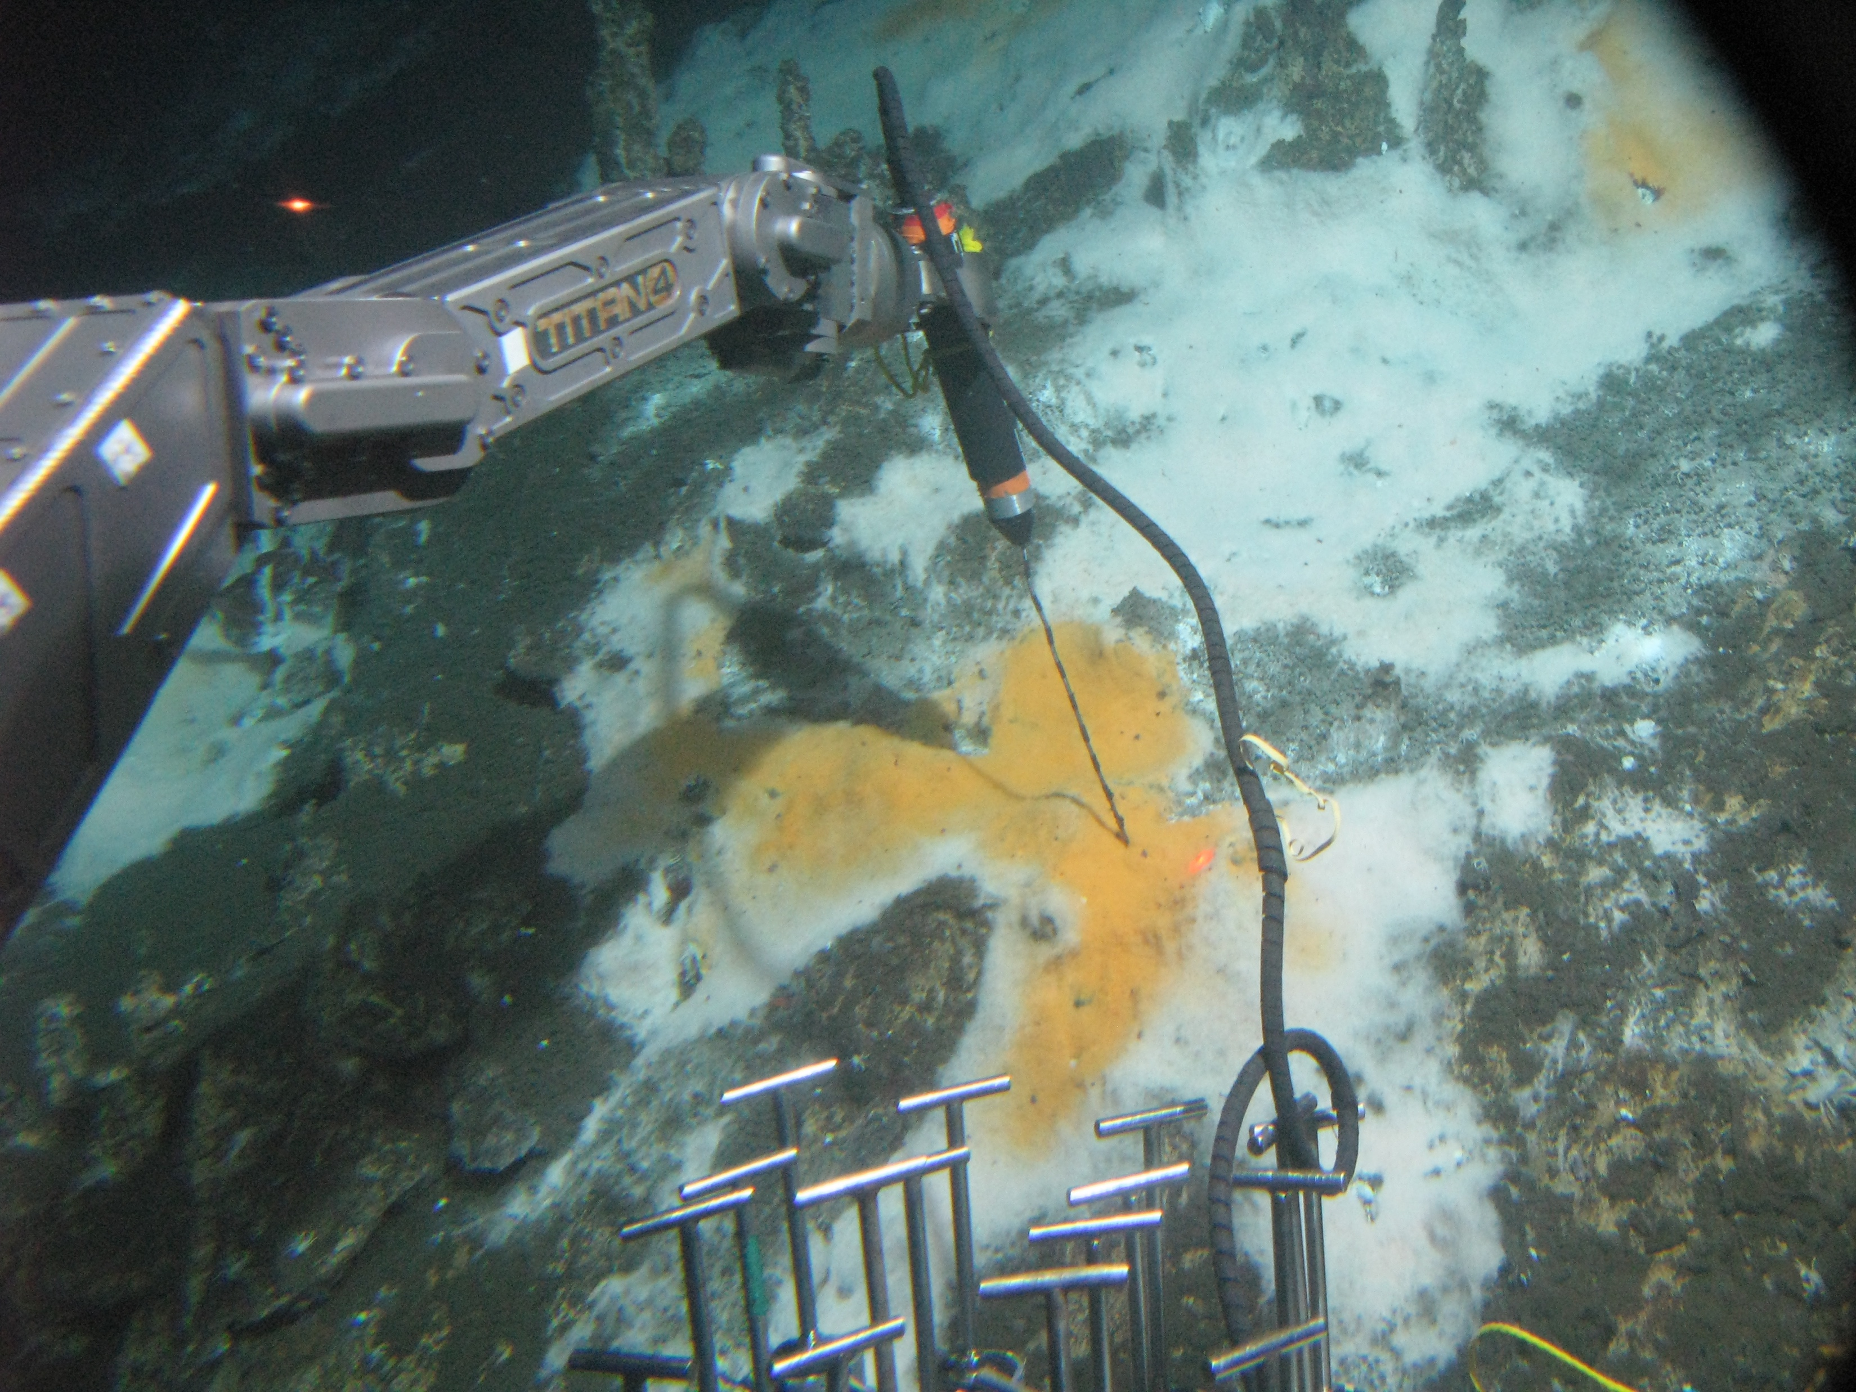
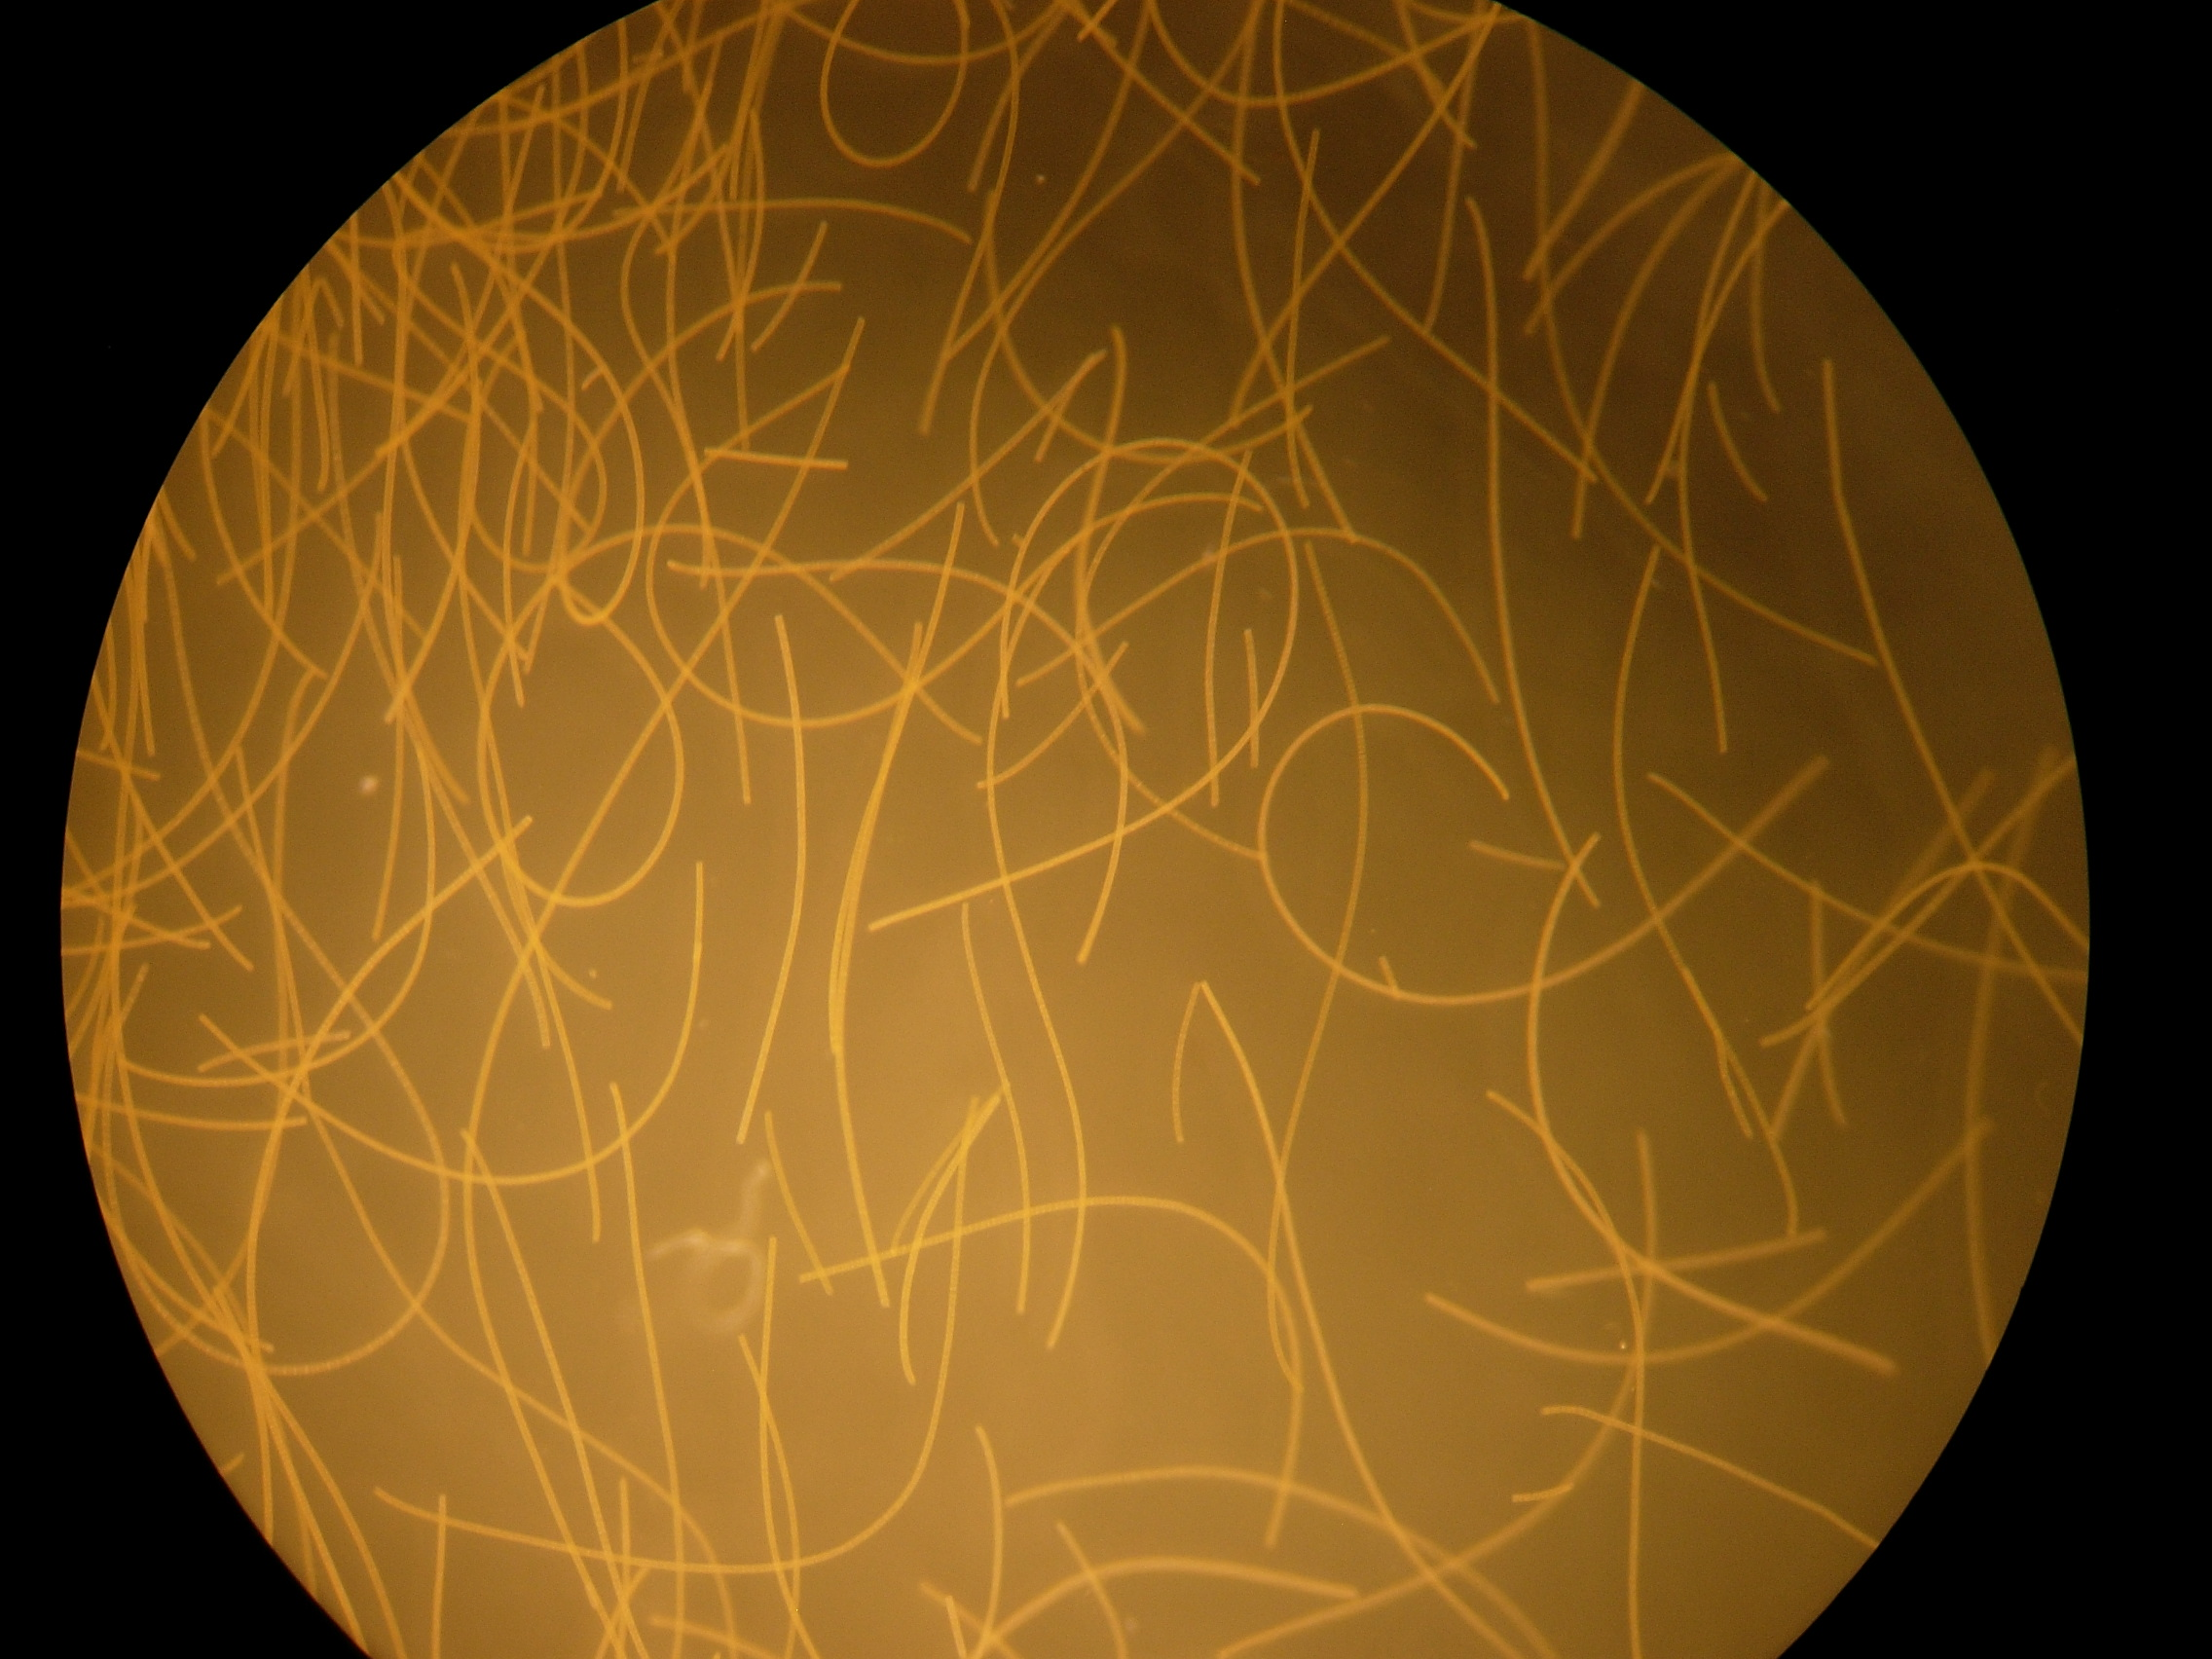
Sulfur oxidizing mats

Slide 17
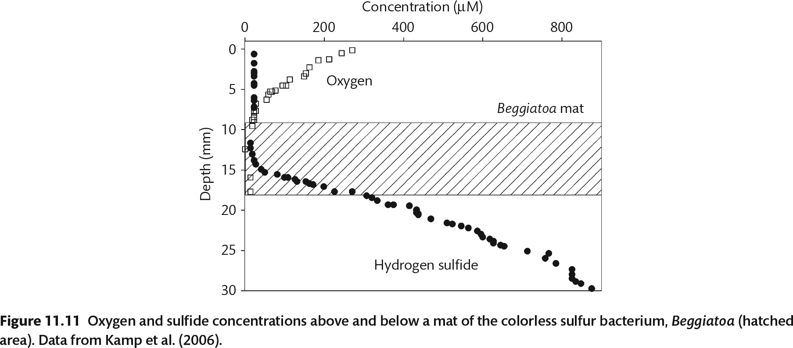

Slide 18
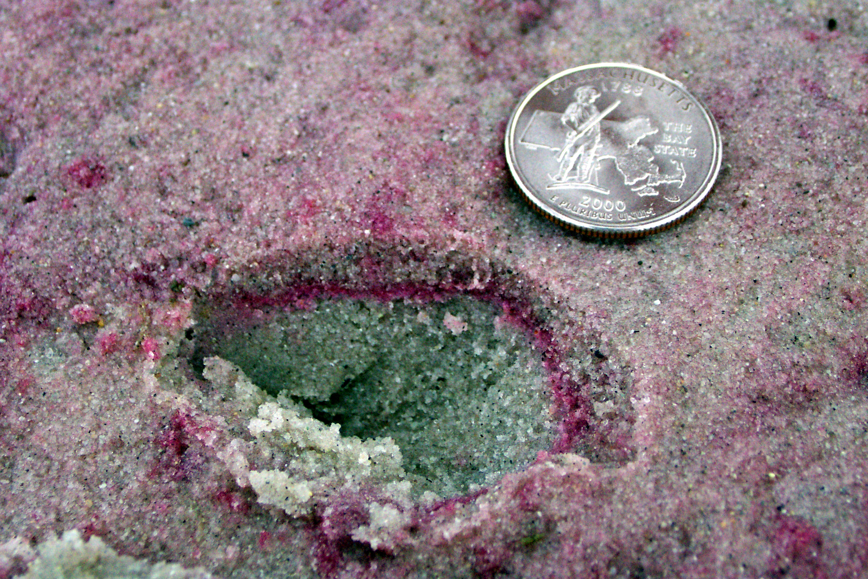
“purple sulfur bacteria”

Slide 19
Table 6. Summary of sulfur-oxidizing anoxygenic phototrophs. “S” and “nonS” refer to sulfur and nonsulfur. Bacteria in this table incapable of using sulfide for photolithoautotrophic growth may oxidize other reduced sulfur compounds, such as thiosulfate and elemental sulfur. Alpha, Beta and Gamma refer to subdivisions of the Proteobacteria. CBB= Calvin-Benson-Bassham (CBB), rTCA = reductive TCA cycle, and 3HPP= 3-hydroxypropionate/4-hydroxybutyrate. Data mainly from (Canfield et al. 2005) and (Sattley et al. 2008).
Microbe | Phylum or sub-phylum | Photolitho-autotrophy with sulfide | Pigments | Aerobic Heterotrophy | C fixation pathway
Purple S | Gamma | Yes | Bchl a,b | Yes | CBB
Purple nonS | Alpha, Beta | No | Bchl a,b | Yes | CBB
Green S | Chlorobi | Yes | Bchl a,c,d,e | No | rTCA
Green nonS | Chloroflexi | No | Bchl a,c,d | Yes | 3HPP, CBB
Heliobacteria | Firmicutes | No | Bchl g | No | None

Slide 20
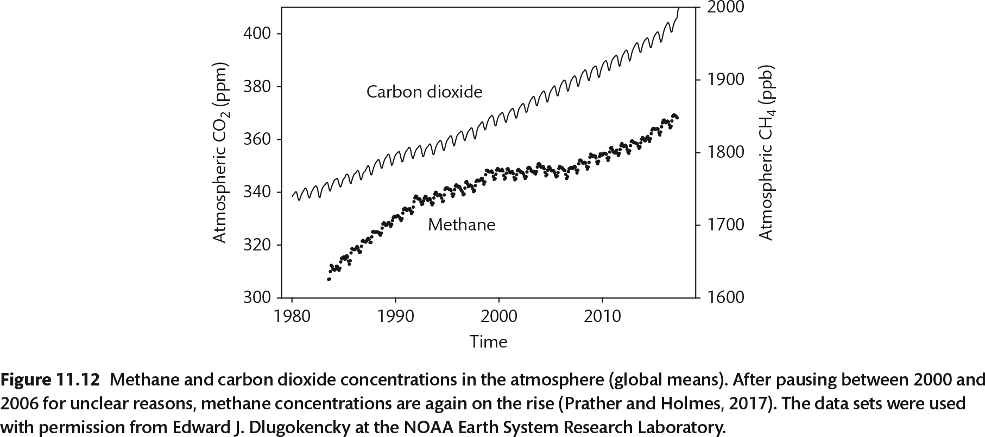

Slide 21
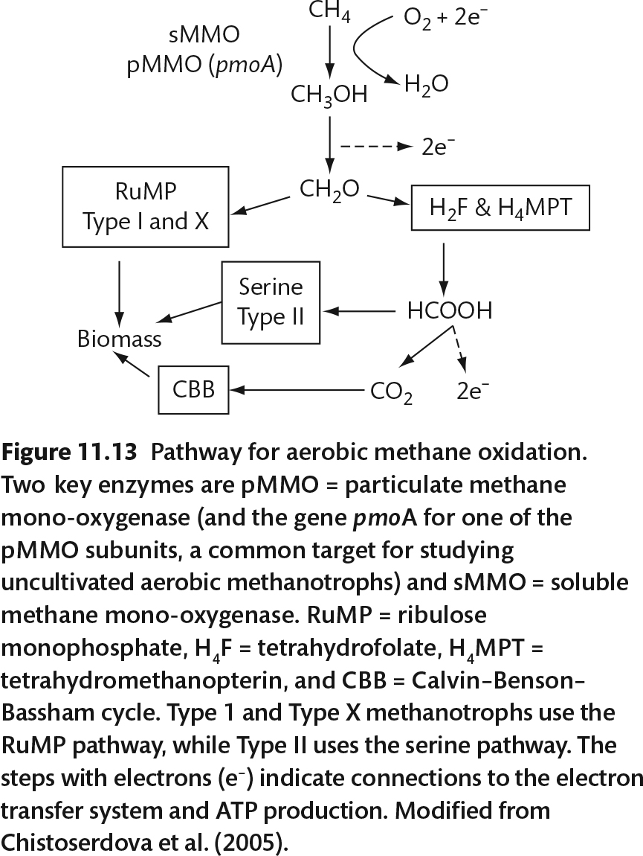

Slide 22
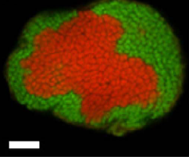
Thermodynamically unfavorable to oxidize methane anaerobically, but it gets done
FISH
Overall reaction:
CH₄ + SO₄⁻² → HCO₃⁻ + HS⁻ + H₂O
Done by 2 separate reactions:
Methane oxidation
Sulfate reduction
Archaea
ANME-2
Bacteria
Desulfosarcina

Slide 23
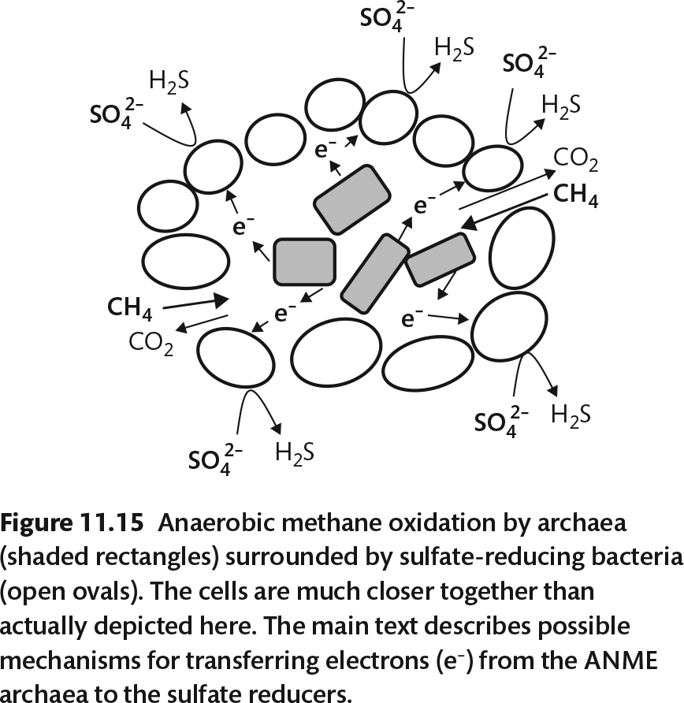
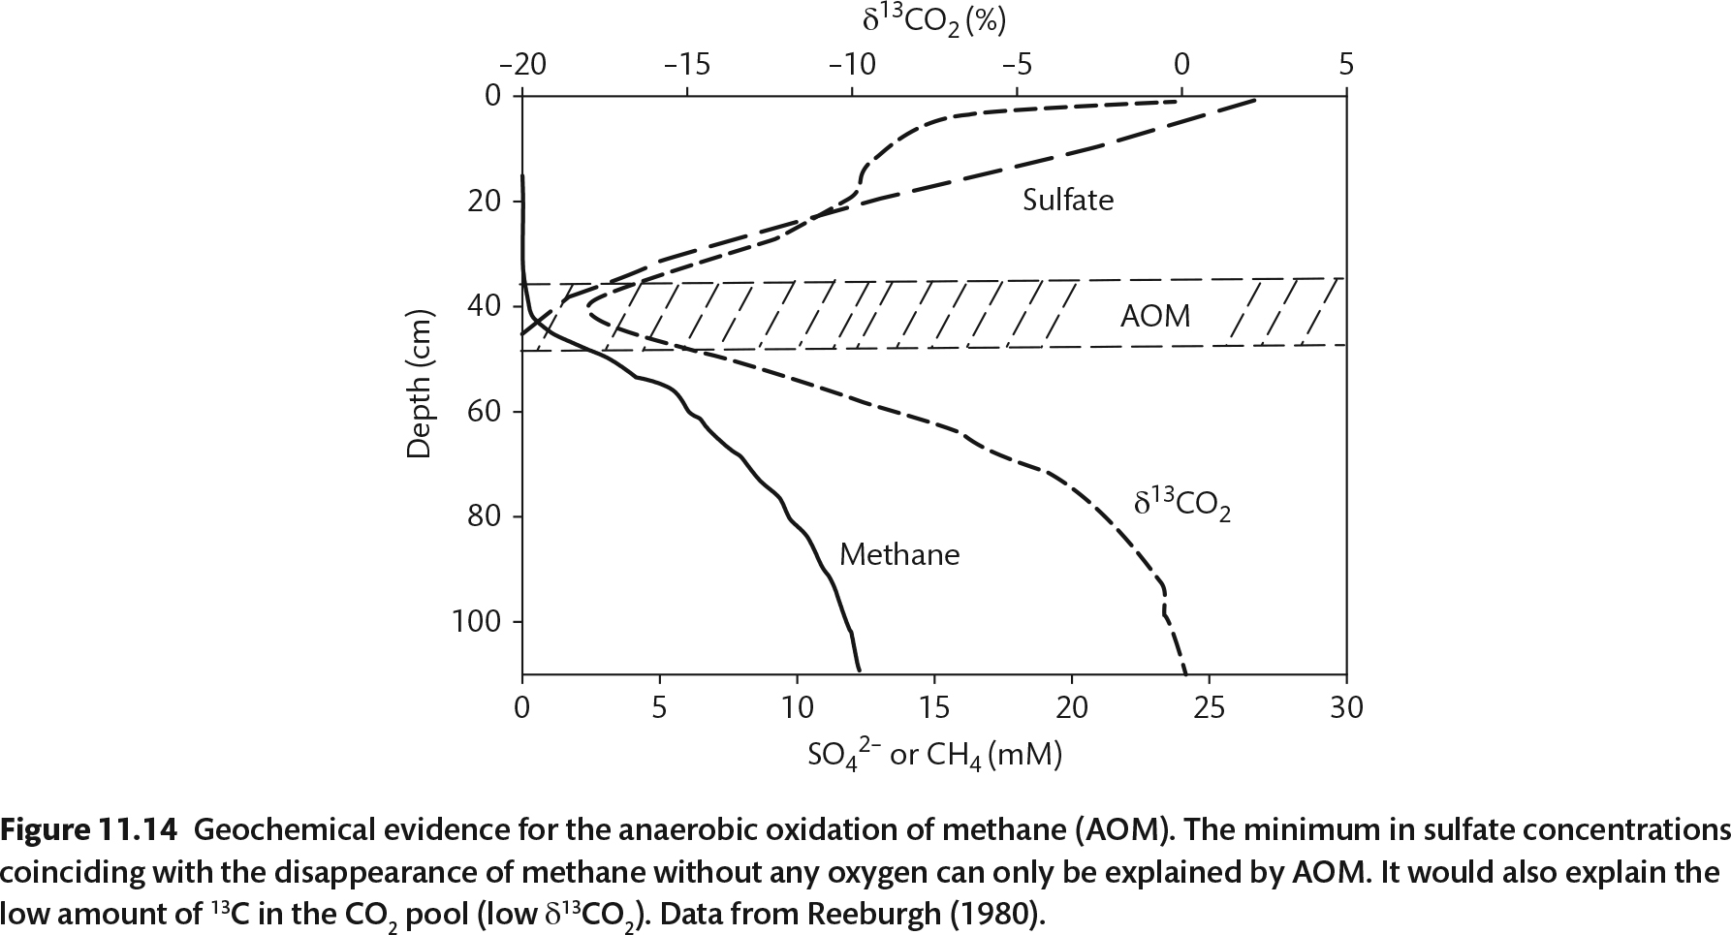

Slide 25
